Slide 1

Final Project
Dalton Murray

Slide 2
Introduction

Slide 3
Problem
An extremely high growth rate in new businesses that are creating more advanced and more complex machinery
Overall better usage in technology
Higher efficiency
Higher effectiveness of the utilization of machinery
It is often difficult to know the limitations of new machinery and remember the limitations of old machinery and to know when it may fail

Slide 4
Initialize

Slide 5
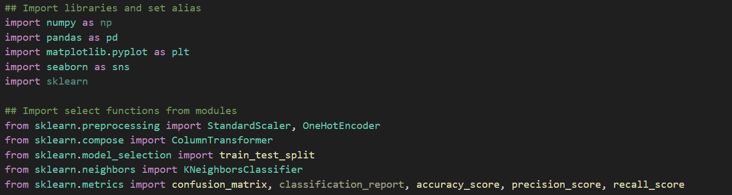
Initialize
Importing libraries and modules
Loading the dataset

Slide 6
Data Insights

Slide 7
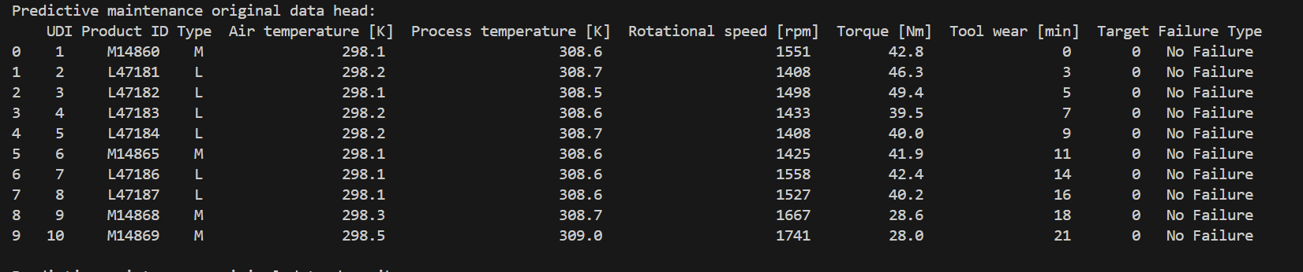
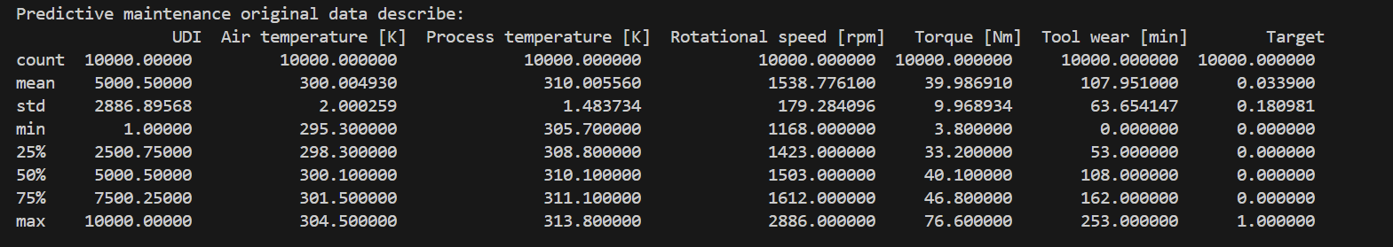
Basic Statistics

Slide 8
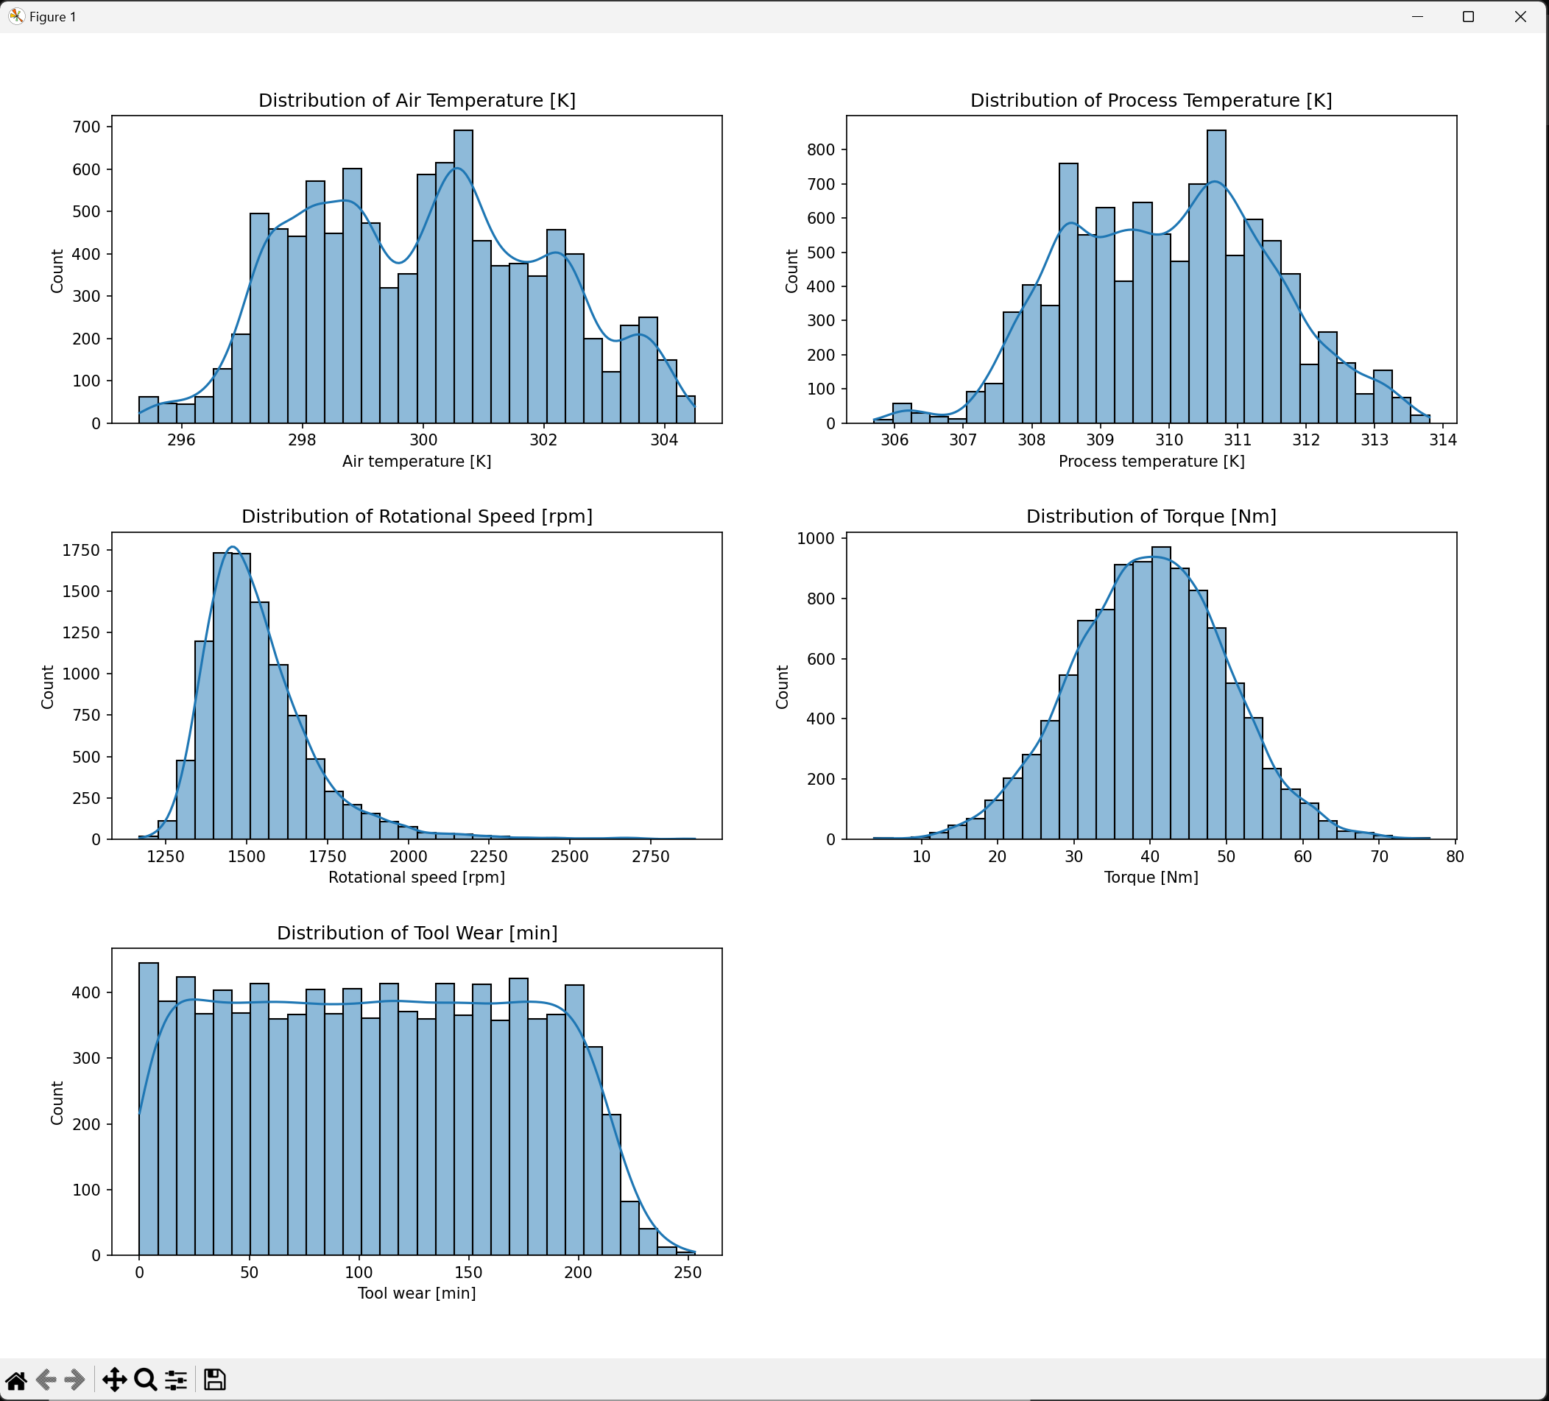
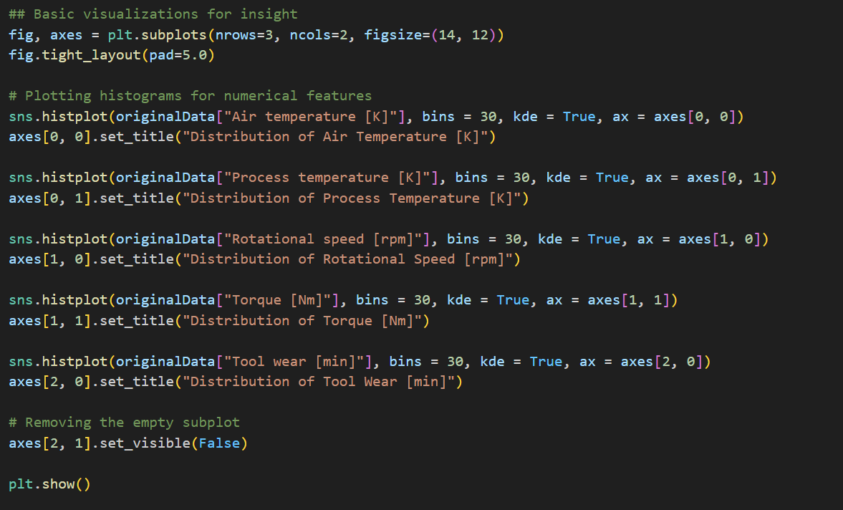
Histograms

Slide 9
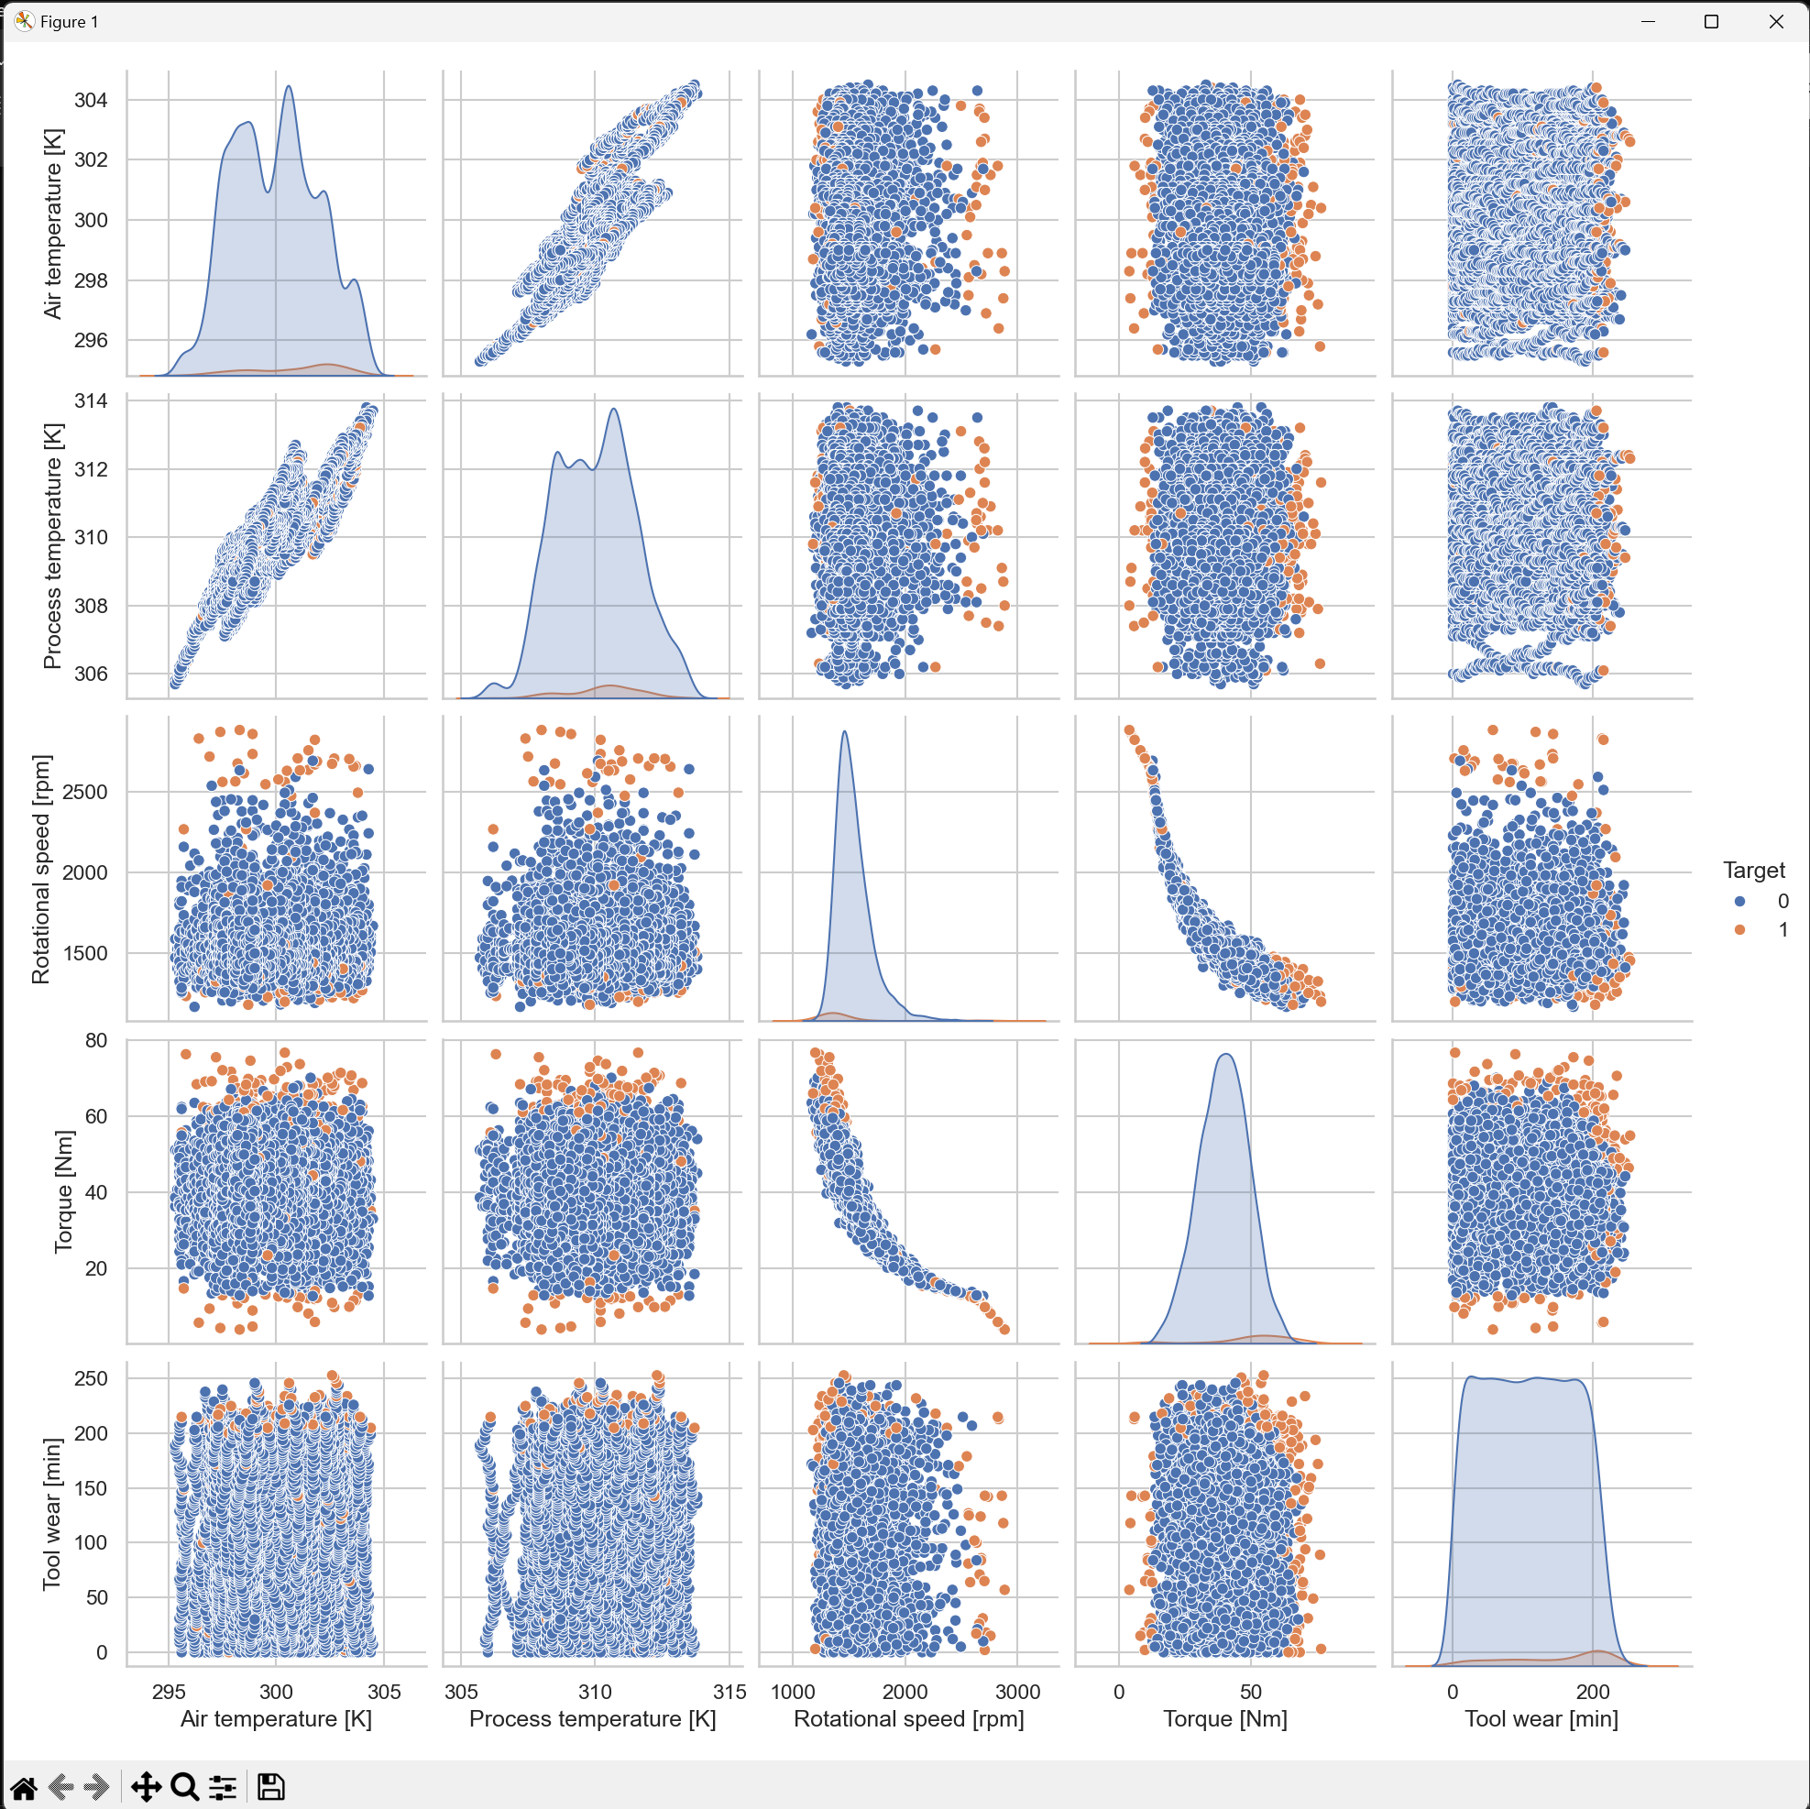
Pairplots

Slide 10
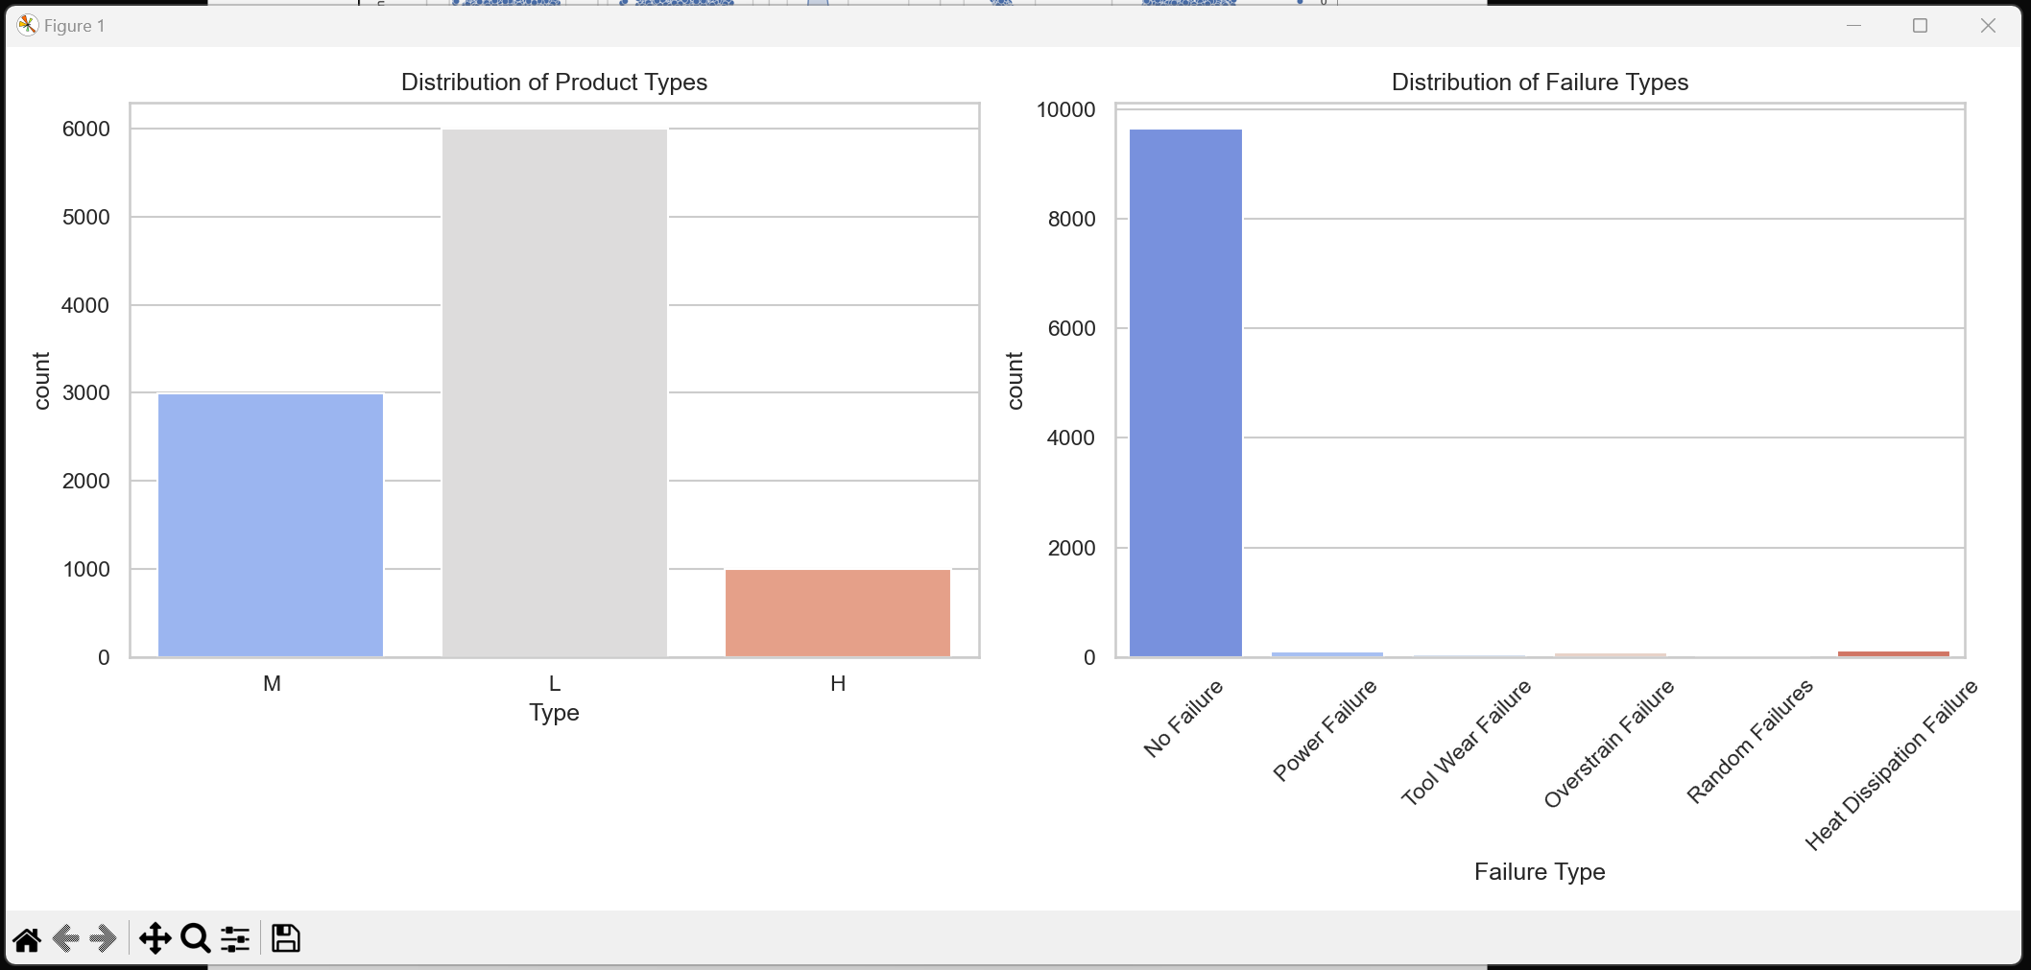
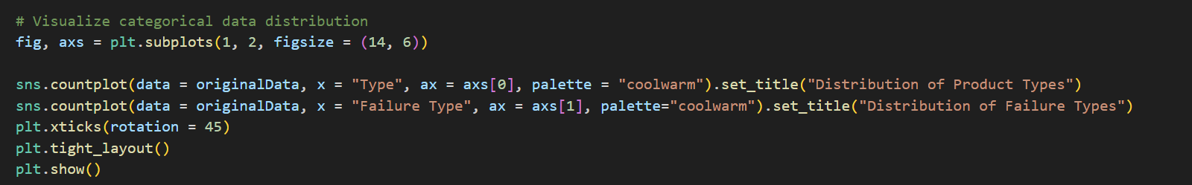
Categorical

Slide 11
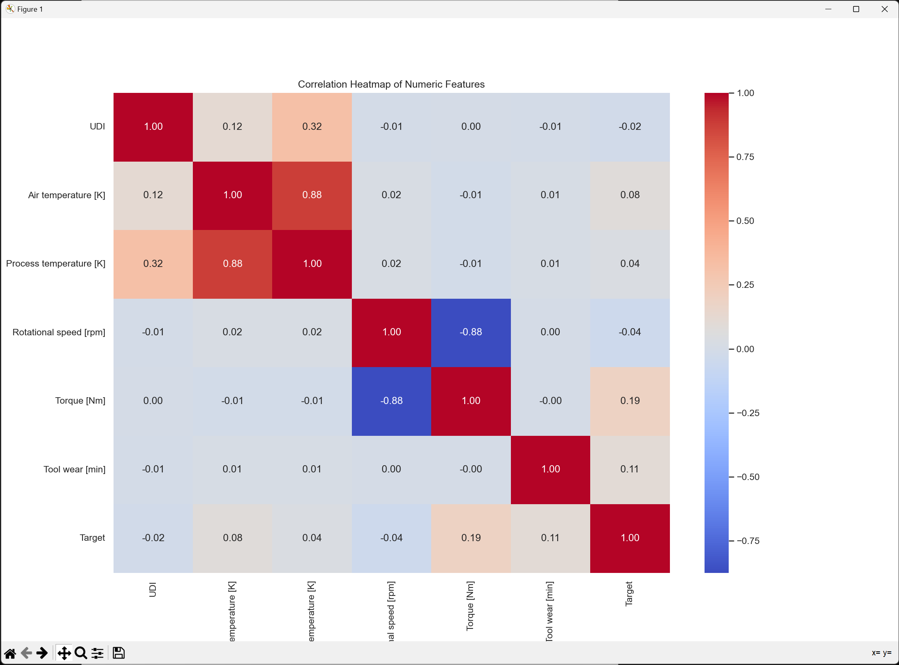
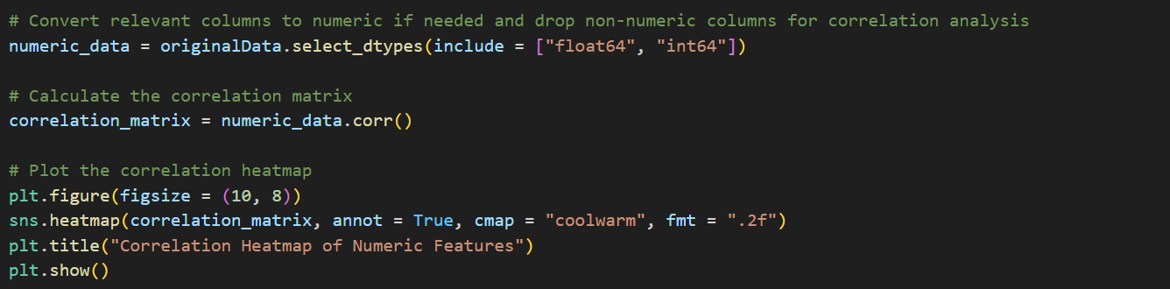
Heatmap

Slide 12
Data Preparation

Slide 13
Data Preparation Start
Conducting analysis on dataset
No real modifications to original dataset required other than to meet requirements
Classes/Failure, No failure
Numerical/categorical features
Transformations
Feature name extraction
Dataframe creation

Slide 14
Failure/Classes mapping

Slide 15
Define numeric and categorical features

Slide 16
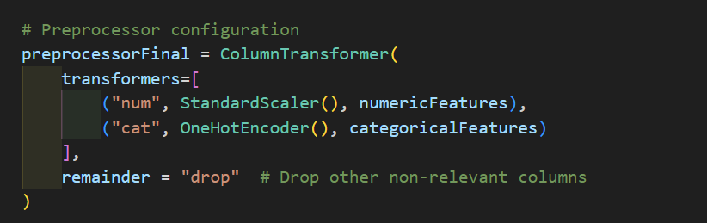
Preprocessing/Transformers

Slide 17
Applying transformations

Slide 18
Extracting feature names

Slide 19
Dataframe creation

Slide 20
Data Partitioning

Slide 21
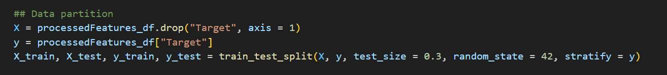
Splitting training/testing data

Slide 22
Values of K

Slide 23

Range of values for K

Slide 24
Training/Testing

Slide 25
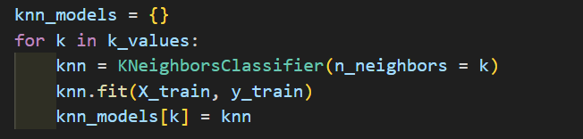
Training/Testing

Slide 26
Evaluation

Slide 27
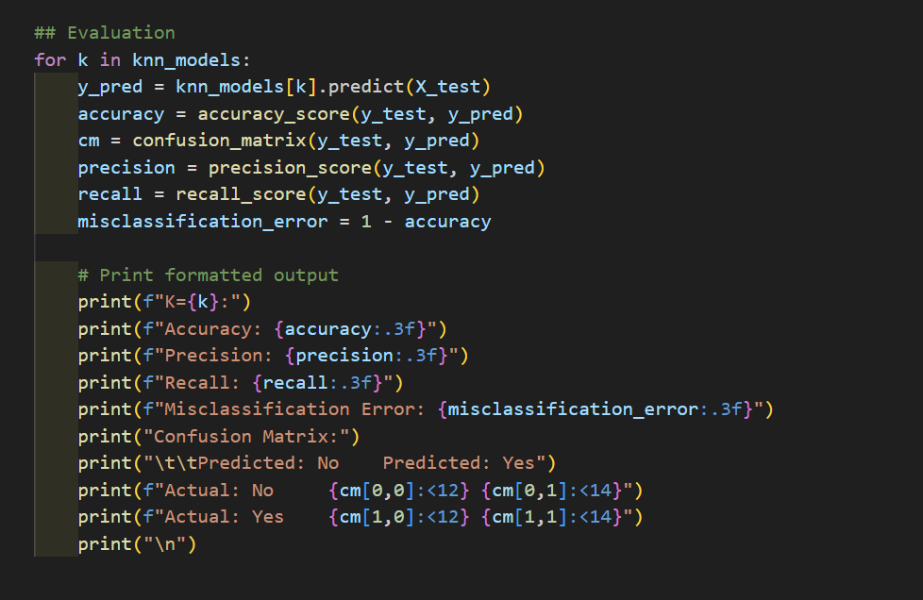
Evaluation

Slide 28
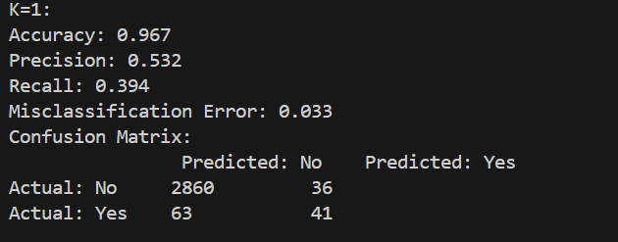
K = 1

Slide 29
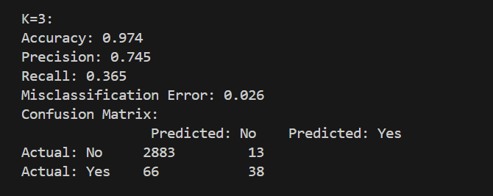
K = 3

Slide 30
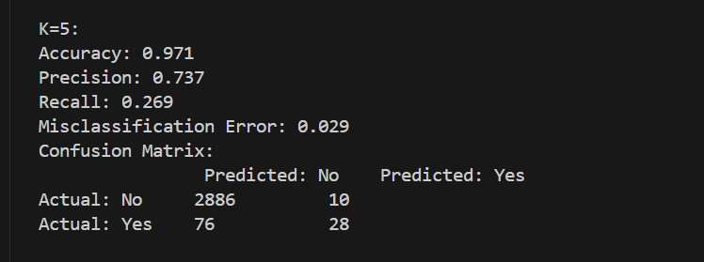
K = 5

Slide 31
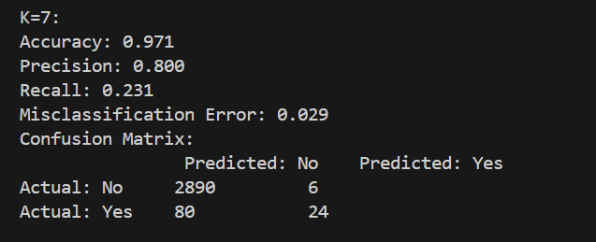
K = 7

Slide 32
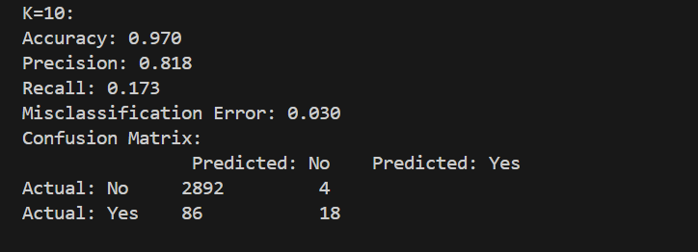
K = 10

Slide 33
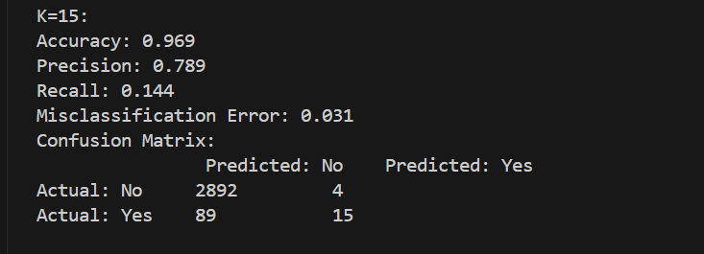
K = 15

Slide 34
Best Model

Slide 35
Selecting a best model
Precision
K = 10
Recall
K = 1
Overall error rate
K = 3
Overall
K = 10

Slide 36
Conclusion

Slide 37
Conclusion
It is possible for a better model to be made
Data
Algorithms
Fine-tuning

